Slide 1
PROJECT REPORT ON USED CAR PREDICTION USING MACHINE LEARNING
AUTHOR: MS. YASHSHREE BAWIKSAR

Slide 2
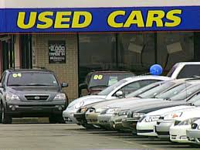
USED CAR PRICE PREDICTION
Due to the increased prices of new cars and the financial incapability of the customers to buy them, Used Car sales are on a global increase
Existing System includes a process where a seller decides a price randomly and buyer has no idea about the car and its value in the present-day scenario
In fact, seller also has no idea about the car’s existing value or the price he should be selling the car at.

Slide 3
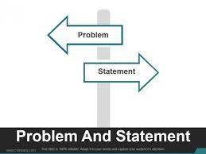
PROBLEM STATMENT
The price of a new car in the industry is fixed by the manufacturer with some additional taxes
With the covid 19 impact in the market, we have seen lot of changes in the car market
In fact, seller also has no idea about the car’s existing value or the price he should be selling the car
Therefore, there is an Urgent Need For A Used Car Price Prediction System which effectively determines the worthiness of the car Using A Variety of Features.

Slide 4

DATASET INFORMATION
Dataset is Scrap from www.cardheko.com
Selenium web driver is used to Scrap data of around 10011 cars
Raw data in excel file contain 10011 rows and 19 feature .
Dataset contain some errors, so data cleaning operation was performed.
Data integrity check is perform for missing values, duplicate data, data error.

Slide 5
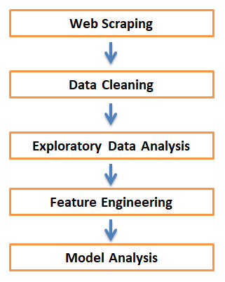
OBJECTIVE
To scrap used car data of at least 5000 cars from cardekho.com
To Analyze data to gain key insights about current used car market
To build Machine Learning model to predict price of used car

Slide 6
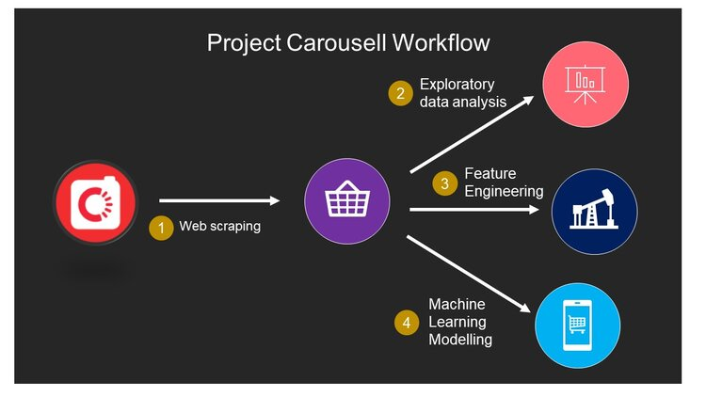
METHODOLOGY OF PROJECT
Phase 1 Web Scraping of Used Car Data from www.cardheko.com
Phase 2 Data cleaning, Data preprocessing on Raw data to create error-free, clean dataset.
Phase 3 EDA to gain key insight about used car market
Phase 4 Building Regression based Machine Learning price predication model

Slide 7
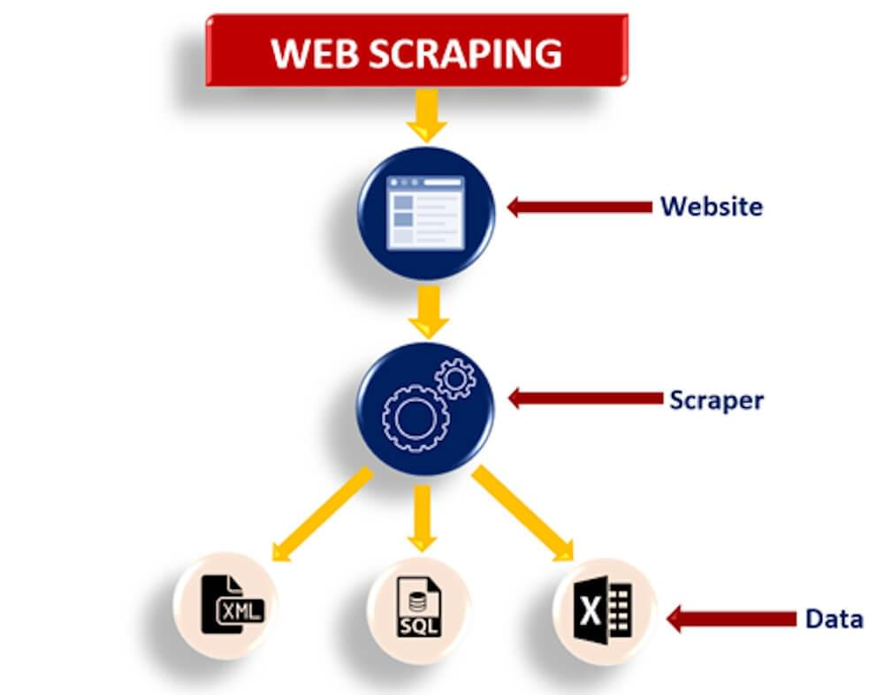
WEB SCRAPING STRATEGY
Phase 1 Web Scraping Strategy employed in this project as follow:
Selenium will be used for web scraping data from cardheko.com
In first part Scraping URL of Used car for different location in India.
Storing Scrap URL in excel file
Selecting car feature to be scrap from website
In second part Scraping data from individual URL in excel file
Exporting final data in Excel file

Slide 8
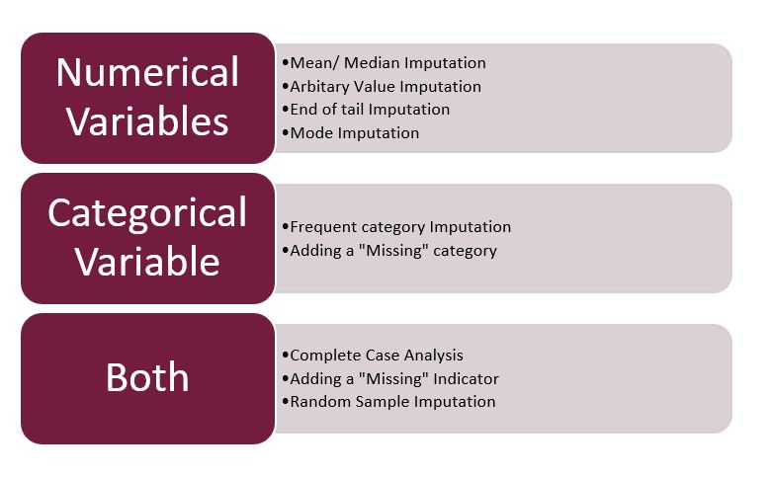
WEB SCRAPING STRATEGY
MISSING VALUE IMPUTATION
After performing data cleaning operation, data for some of feature is missing.
Strategy for Handling missing data :
Imputation for categorical data done with mode of category
Numerical value can be imputed with mean or median depending on sensitive to outliers

Slide 9
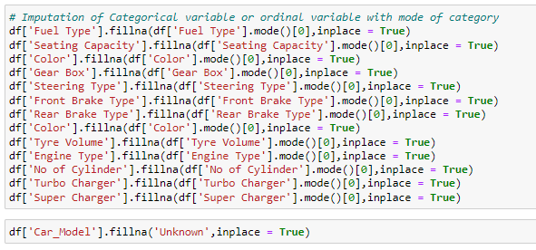
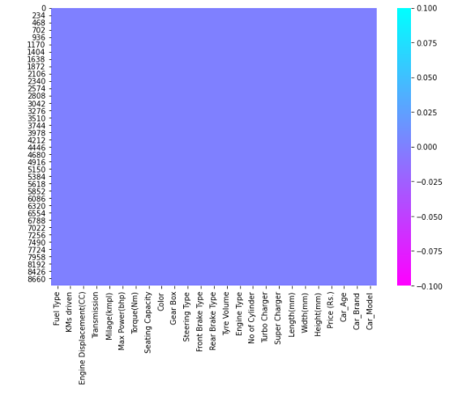
MISSING VALUE IMPUTATION
Heat map of Missing Value After Imputation
Imputation of Missing Value for Categorical Variable

Slide 10
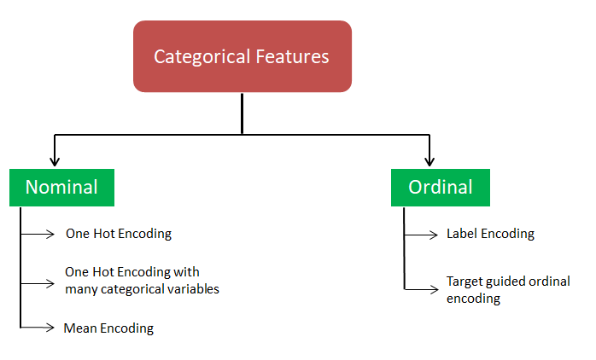
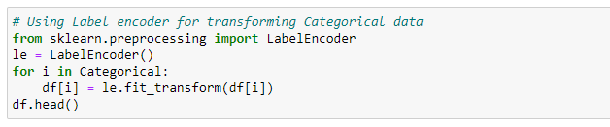
LABEL ENCODING OF CATEGORICAL DATA
Categorical features are transform using label encoding.

Slide 11
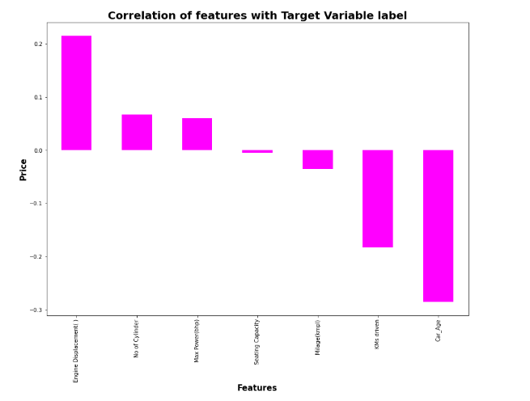
Data Inputs- Logic- Output Relationships
We can see most of feature are either poorly or moderately correlated with target variable Price.

Slide 12
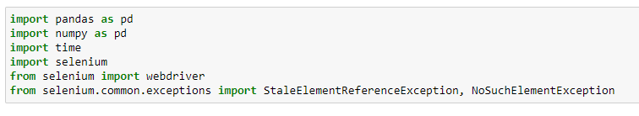
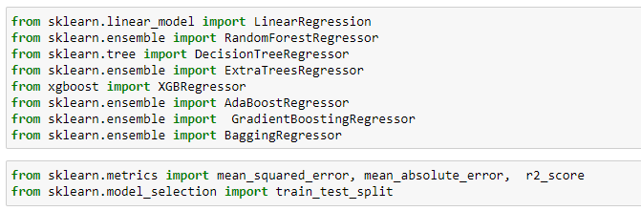
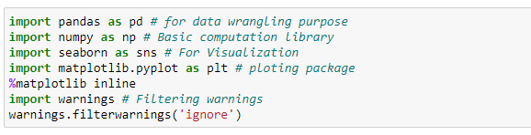
PYTHON LIBRARIES USED IN THIS PROJECT
Different libraries used for web scraping
Machine Learning model building libraries
Visualisation libraries used

Slide 13

Exploratory Data Analysis
Let’s Start’s to Exploring the data to get some insights

Slide 14
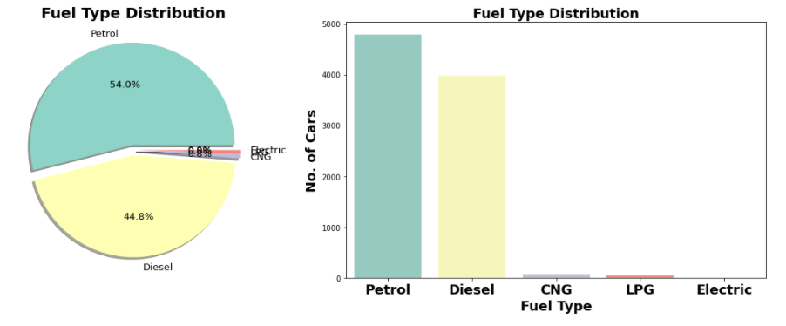
FUEL TYPE DISTRIBUTION
Most of car are Petrol operated followed by Diesel. This may be due to low prices of Petrol car compare to diesel car.

Slide 15
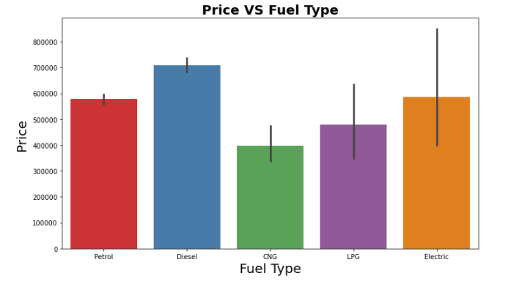
PRICE VS FUEL TYPE DISTRIBUTION
Very small segment of electric car and also price is quite high compare to petrol based.
CNG based car are Cheapest compare to others.

Slide 16
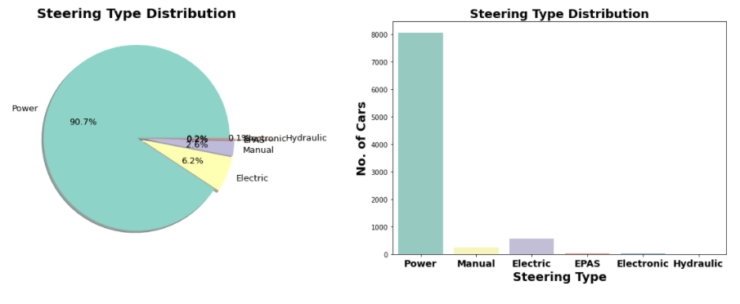
STEERING TYPE DISTRIBUTION
More than 90 % of car users prefer Power steering compares to others

Slide 17
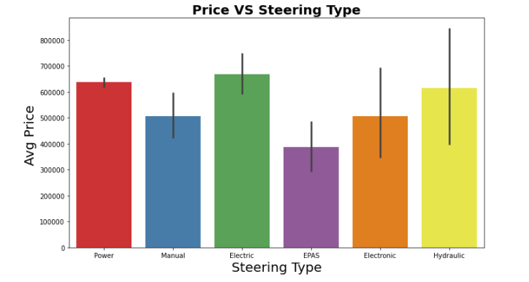
PRICE VS STEERING TYPE DISTRIBUTION
6.2% car based on electric steering, which is costly compare to others.
Very small section of car still uses Manual Steering, Most probably they belong to old model.

Slide 18
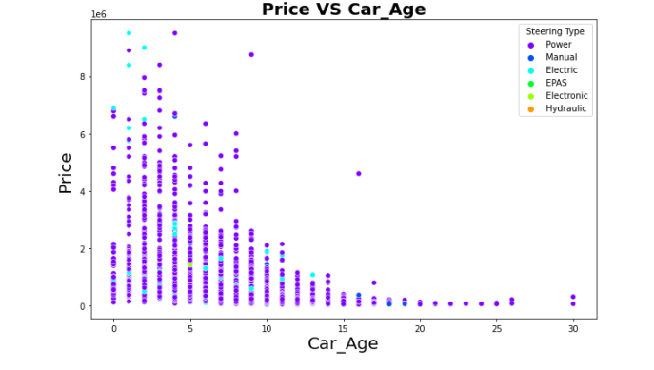
PRICE VS CAR AGE
Here we got confirmation of prediction in previous section, almost all manual steering-based car at least 10-year-old

Slide 19
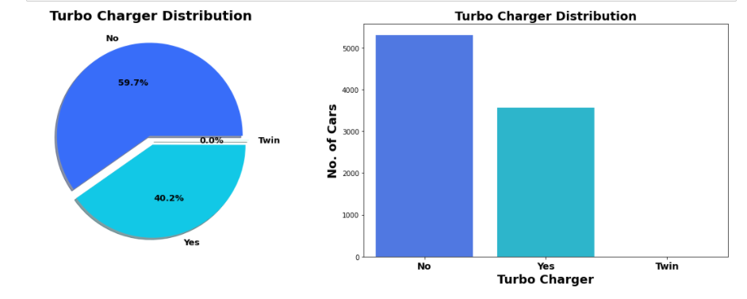
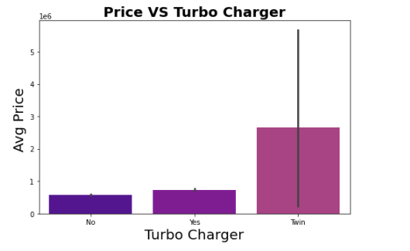
PRICE VS TURBO CHARGER
PRICE VS CAR AGE
40% cars are with turbo charger & almost less than 1 % car with twin facility
As expected, Max price for car based on Twin engine followed by with turbocharger.

Slide 20
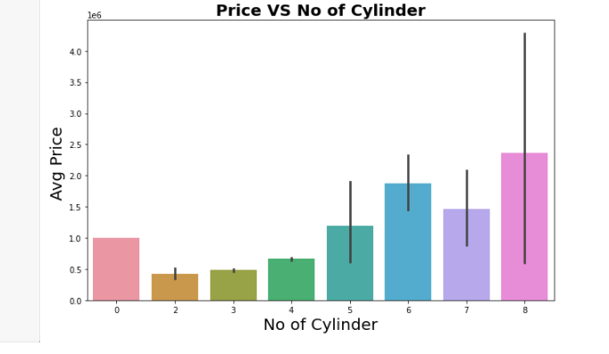
NO OF CYLINDER VS PRICE
From value counts we got information that most of Cars with are 4-cylinder engines followed by 3-cylinder engines.
In terms of Avg. Price as number of cylinders increases the average price increases.

Slide 21
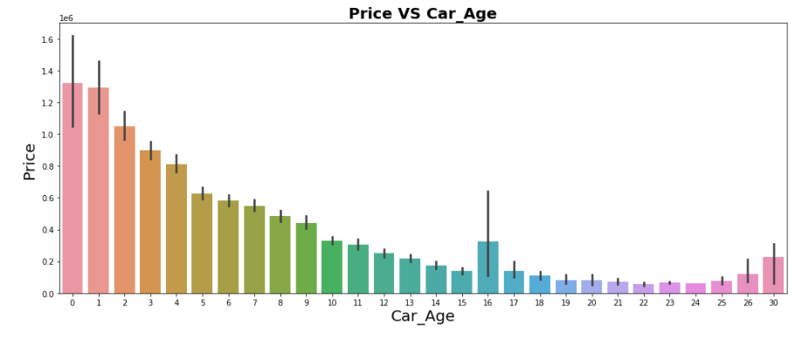
CAR AGE VS PRICE
As car get older, price of car deprecates.

Slide 22
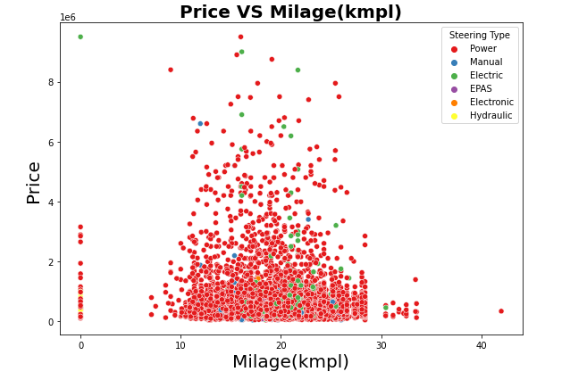
PRICE VS MILAGE
Milage (kmpl) varies in between 10 to 25 kmpl for most of cars. For Majority cars price is below 0.5e6.

Slide 23
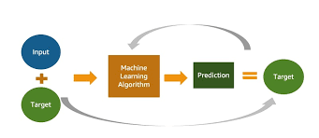
MACHINE LEARNING MODEL BUILDING

Slide 24
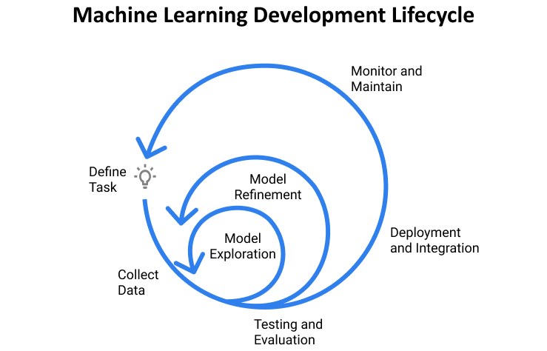
MACHINE LEARNING MODEL BUILDING
Objective is to predict price of used car . It can be solve by application of regression ML algorithm. Different Regression algorithm used to train model, in order build ML model with maximum R2 Score.
Machine learning classification algorithms used in this project are –
Random Forest Regressor
Decision Tree Regressor
XGB Regressor
Extra Tree Regressor

Slide 25
ML MODEL EVALUATION MATRIX
On Basis of difference between R2 Score and Cross Validation Score Decision Tree Regressor is selected as best model with 91.79% R2_score.
Final Model is giving us R2 Score of 92.29% which is slightly improved compare to earlier R2 score of 91.79%.
Algorithm | R2 Score | CV Score | R2 Score - CV Score
Random Forest Regressor | 83.70 | 75.99 | 7.29
Extra Tree Regressor | 80.32 | 74.97 | 12.41
Decision Tree Regressor | 67.36 | 58.66 | 28.72
XGB Regressor | 87.38 | 81.46 | 5.92

Slide 26
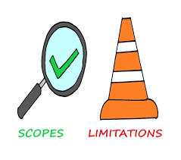
LIMITATIONS & SCOPE FOR FUTURE OF THIS WORK
Around data for more than 10000 car scrap from cardheko.com
We can scrap more data from different online platform like olx, car24. More data obviously means more accurate predication.
Here we Scrap almost 24 features. But there are many different kinds of safety, comfort, entertainment features to which buyer weight while buying car. We can also include such more feature in future.

Slide 27


